Slide 1
Final exam revision: Preparation, test taking on Inspera and recapping our core methods
Week 11 – Exam preparation
POL 2017

Slide 2
Today’s lecture
Exam format overview
Recap of the three methods that are covered on the final exam
Final exam writing exercise
You will have the chance to practice answering an exam question in the allotted time. Brian and Skyler will be available to answer questions should you have them, and this writing will serve as the basis of our discussion in this week’s seminars.

Slide 3
Revision hints for the final exam
For times and room details, please refer to your own exam timetable.
Check you can log into a university computer ok.
Next, download the “Assessment 2 Guide - Final Exam”
This document is your first stop of any questions regarding the final exam
Based on the guidance from the above guide, make a realistic revision plan.
Consider rewriting or formatting your lecture and seminar notes so that they can serve a support guide for your final exam writing.
Have a go at the practice questions and bring your responses to this week’s seminar.
A quick note on illness and other extenuating circumstances
There are no extensions given on in-person exams.
If you are unwell or have other extenuating circumstances that mean you miss the exam, you need to submit a PEC form requesting to defer the exam until the August assessment period.
The August resit will be an exam of the same format.

Slide 4
Format for the final exam
This is an Inspera Digital Exam.
Read all three questions first.
Plan out the structure of your answer before you begin writing the essay.
Tip: if you run out of time, put your remaining ideas down as bullet points in your submission text box.
When studying for the exam you should cover all three of the research methods, as this means you can pick whichever research scenario you prefer.
There is not set word limit, so try to balance your time between your two responses.
As a general principle, we expect one of two citation formats:
For general mentions of authors’ names:
Halperin and Heath note that interviews are…
For fuller in-text citations with years:
An interview is a qualitative method used by… (Halperin and Heath 2020).
NOTE: If you include either heavy paraphrasing or direct quotes, page numbers are required.

Slide 5
Recap
Research Questions (W2)
Surveys (W5,W6)
Content analysis (W7, W8)

Slide 6
Types of research question
Descriptive
Explanatory
Predictive
Prescriptive
Normative

Slide 7
What makes a good question?
Relevance
Who cares? Societal, academic relevance
Clarity
Is the question easily understood and well defined?
Scope
Is the question too narrow, or too broad?
Feasibility
Is the question answerable? Time, skills, resources

Slide 8
Surveys

Slide 9
Surveys
Gather information by asking people questions
Find out what sections of society think or do
Can be used for description & explanation
What questions can we ask to try and measure our key concepts?
From concepts to variables

Slide 10
Surveys
Question types
Open questions
Closed questions
Variable types:
Nominal
Ordinal
Interval
Ratio

Slide 11
Surveys
Survey design
Which questions to ask
How many questions to include
Question ordering effects
Question design
Wording & comprehension
Recall
Misreporting
Subjective & objective measures
Double-barrelled questions
Leading questions
Response options
Attention

Slide 12
Surveys
Strengths
Lots of data from lots of people
Relatively low cost
Generalisability
Reliability
Versatility
Weaknesses
Inflexible
Validity
Bias
Lack of depth

Slide 13
Survey Sampling
Probability sampling:
Simple random
Systematic
Stratified
Cluster
Non-probability sampling:
Quota
Snowball
Purposive
Convenience

Slide 14
Survey Sampling
Sampling approach will depend on our research question
We will need to consider our:
Target population
Sampling frame
Sample
Sample Unit

Slide 15
Survey Mode
The format in which we ask our questions can impact:
Measurement error
How people answer our questions
Sampling error
Who answers questions
Survey modes:
Face to face surveys
Telephone surveys
Postal surveys
Internet surveys

Slide 16
Survey Mode
When deciding on survey mode, we should consider:
Cost
Sampling frame
Comprehension problems
Interviewer effects
Coverage/sampling error
Non-response

Slide 17
Ethics
Potential harms of our research
Sensitive topics, context of participation
Informed consent
Voluntary participation
Privacy
Anonymity, confidentiality, identification, data security

Slide 18
Content Analysis

Slide 19
Summary
Content analysis:
Systematic analysis of texts or other media
Can analyse a wide variety of documents
Across huge range of issues
Unobtrusive method of data collection
Can examine otherwise inaccessible subjects
Can’t explore subsequent effects of the content

Slide 20
What content can we analyse?
Audio-visual
Interviews
Campaign ads
Conference speeches
Posters
Film
TV programmes
War photography
Text
Speeches
Social media posts
News reports
Manifestos
Legislation
Policy documents
Campaign materials

Slide 21
Types of content analysis
Quantitative
Positivism
Validity, reliability
Manifest content
Qualitative
Interpretivism
Plausibility
Latent content

Slide 22
Types of content analysis
Inductive coding
Read texts carefully, and create coding categories as we go
Open/grounded coding
Does item fit with existing code? If not, create new category
Deductive coding
Define pre-set categories beforehand that will be coded
Based on theory or existing research
Closed coding

Slide 23
Summary
Qualitative content analysis
Plausible categories
Explanation of coding decisions
Quantitative content analysis
Internal and external validity
Intra and inter-coder reliability

Slide 24
Summary
Stages of content analysis:
Research questions/hypotheses
Case selection
Units of analysis
Categories
Coding
Analysis

Slide 25
Interviews

Slide 26
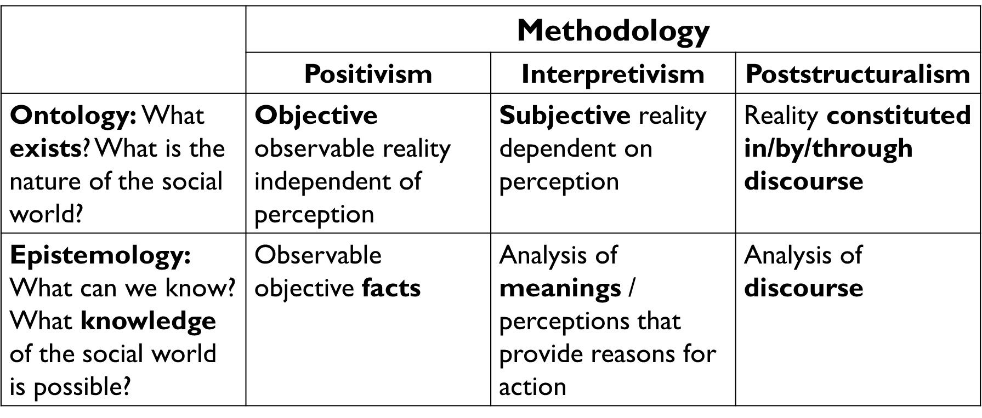
The Three Methodologies in POL 2017

Slide 27
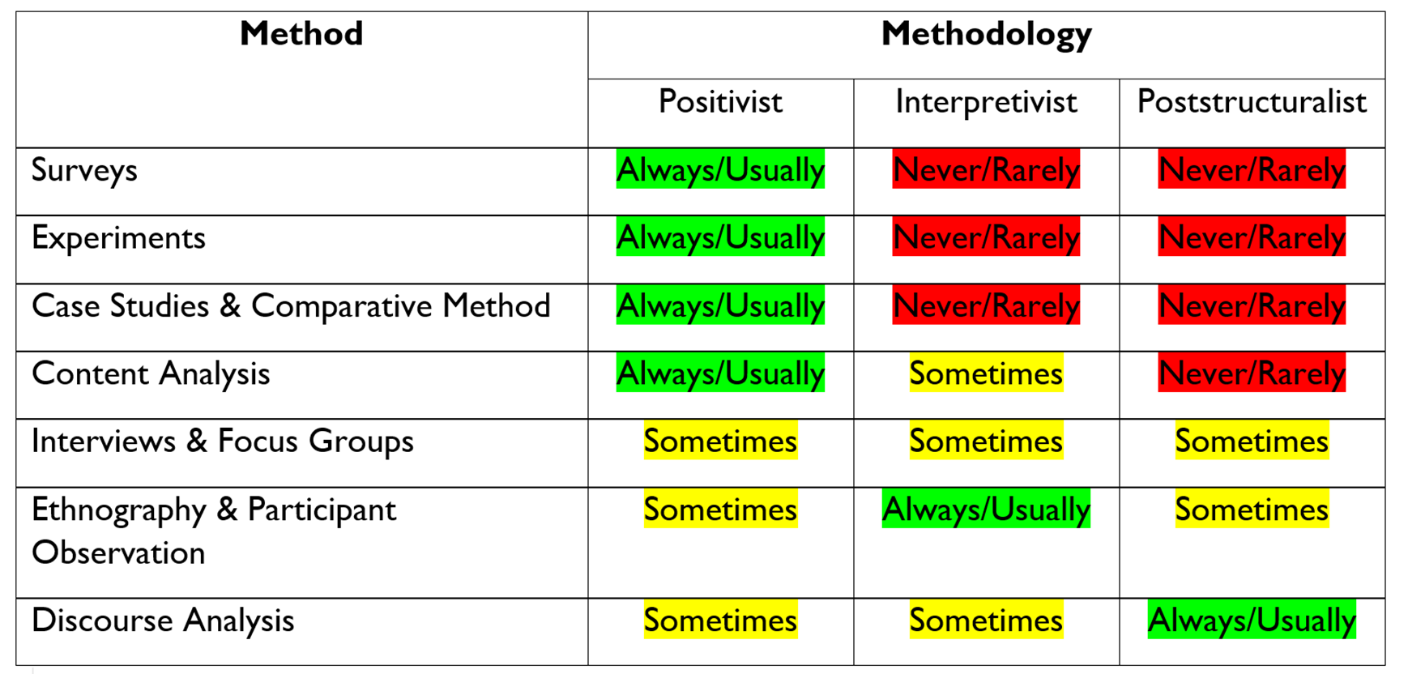

Methodology and Method

Slide 28
Interviews and focus groups
There are both positivist and interpretivist approaches to interviewing
Interviewing 101: Weeks 9 and 10
What are the different types of interview?
Designing and ordering your interview questions
Sampling for interviews and the difference in positivist and interpretivist approaches to sample size
It will be important to consider the methodological differences when writing on this method for your final exam, and in choosing your dissertation or project methods.

Slide 29
Interviews
There are three types of interviews:
Structured: Questions are short, simple, and highly standardized.
Semi-structured: Mixture of shorter, standardized questions, and those that are longer, more open and more complex.
Unstructured: Uses a set of topics to help carry on a conversation with a less formal structure.
Group: Interviewing 2 or more participants at the same time, using a set of pre-determined questions or topics, and actively engaging with them as they respond and interact with one another
Points to remember:
Structured interviews tend to have the same short questions asked in the exact same order for all respondents. The questions and the order of the questions are not exactly the same for all respondents in Semi-structured and Unstructured interviews.
Although the researcher’s questions and assumptions might vary depending on their chosen methodology, the method itself is pretty similar.
Group interviews are not the same as focus groups.

Slide 30
Interviews and focus groups
Stages of the Interview:
Introduction
Warm up
Main body
Cool off
Conclusion
Focus group:
Pose questions to a group of respondents who are selected based on particular shared characteristics and/or experiences that are relevant to the research question.
Remember: The role of the researcher in a focus group is that of a moderator. This is the main characteristic that sets a focus group apart from a group interview.

Slide 31
Political interviews
Week 10 recorded lecture builds on these questions:
Who has been interviewed and what are their similarities and differences in their responses to the questions?
What kinds of questions were asked to them?
What sorts of core or recurring themes emerge from their responses?
What are things that you notice such as body language, dress, tone of their voice when responding to different questions?
What does the video give us, if anything, about the time, place and setting of the event?
What are the styles of questions asked: personal, demographic, opinion, short or more in-depth?
The interview schedule
The ethics of interviews and ethnographic research

Slide 32
Break

Slide 33
Practice Exam Questions
You are planning to conduct a research project about political candidates using social media during political campaigns, using content analysis.
You are planning to conduct a research project on public attitudes towards foreign policy using survey methods.
You are planning to conduct a research project on experiences of MPs of colour serving in UK Parliament using interviews and/or focus groups.
What kinds of research questions could you ask?
How would you use this method to answer them?
What are the main strengths and limitations of this method you would need to take into consideration?

Slide 34
Week 11 Exam preparation
Drs Boyle and Hawkins thank you for a wonderful semester ☺
For additional support ahead of the exam on 22 May, drop-in hours during the week of 13 May and 20 May will be posted to Canvas and reminders sent through Canvas announcements.

